Slide 1
Meeting Week 2 – Hybrid modeling Dual-Gantry
Last week summary
ASMPT meeting
  Key metric
Action point 1
…
Question 1
…
Outline ToDo next week
  Choose method → research for that
  Look into estimating plant / SI for that application
  Currently “too vague” to have a clear planning?

Slide 2
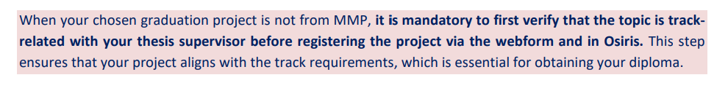
Last week summary
Research plan
  AI&ES relevance: Machine learning on dual-gantry system suffices
Study guide graduation project
  Track High-tech systems and robotics

Slide 3
ASMPT
ASMPT will provide:
  They will develop initial FP model in ~2 weeks
  Will enable me to automate data collection on the dual-gantry setup (not data experiment design)
Critical metric: settling error bounds
  For performance: initial movement reference tracking not as important
    Hysteresis is also applicable (= previous movements effects gantry initial movement)
Generic approach for obtaining data for experiments experiment
  Need to design “smart” tests rich in information and for unseen data validation
  Would be beneficial for them if its also applicable on other setups
Augmentation Kessels was effective on wire bonder → proposes orthogonality in limitations
(Look at mapping multiple nonlinearities, unseen flexible modes)

Slide 4
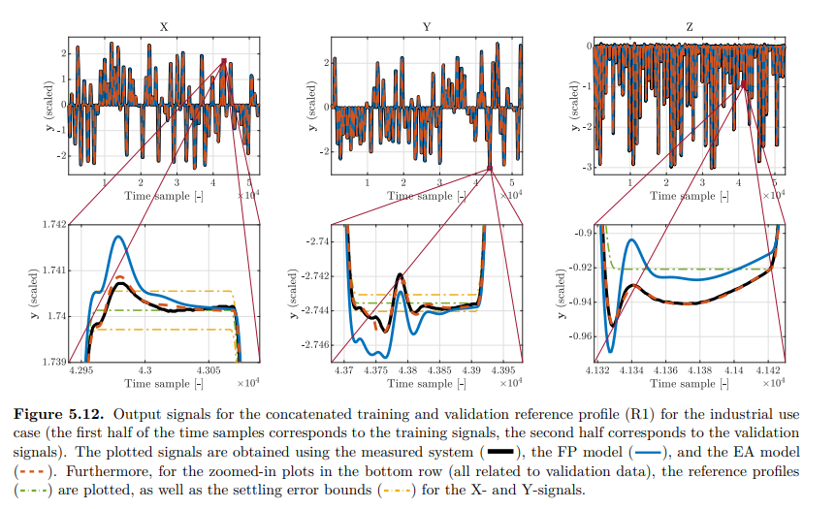
Settling error bound for Dual-Gantry
Bas Kessels paper
maximum allowed deviation of the system's output (position) from the reference trajectory after a specific amount of time has passed (the "settling time") / settling phase: the moments immediately after the reference profile reaches its target position.
FP often fails due to unmodeled dynamics
Goal of augmentation: reduce settling error bounds from FP model / telica settle times as baseline
Instead of RMSE → Target the Peaks; Settling time is determined by the last peak that exceeds the yellow limit line. Even with low RMSE peak could exceed
Feature selection Time Extremum (TE): magnitude and temporal location of local extrema (peaks and valleys) in the error signal; Kessels in application found not to be useful → instead weighted cost function for the peaks?
(Define start and end settling: reference trajectory velocity and acceleration 0 end when new movement begins)

Slide 5
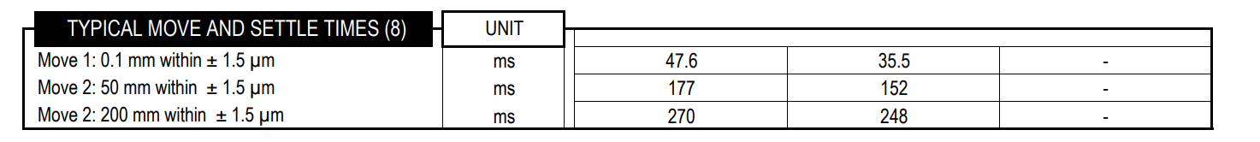
Settling error bound for Dual-Gantry
Bas Kessels paper
maximum allowed deviation of the system's output (position) from the reference trajectory after a specific amount of time has passed (the "settling time") / settling phase: the moments immediately after the reference profile reaches its target position.
FP often fails due to unmodeled dynamics
Goal of augmentation: reduce settling error bounds from FP model / telica settle times as baseline
Instead of RMSE → Target the Peaks; Settling time is determined by the last peak that exceeds the yellow limit line. Even with low RMSE peak could exceed
Feature selection Time Extremum (TE): magnitude and temporal location of local extrema (peaks and valleys) in the error signal; Kessels in application found not to be useful → instead weighted cost function for the peaks?
(Define start and end settling: reference trajectory velocity and acceleration 0 end when new movement begins)

Slide 6
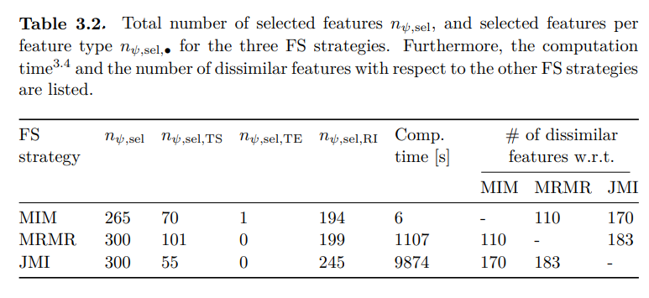
Settling error bound for Dual-Gantry
Bas Kessels paper
Instead of RMSE → Target the Peaks; Settling time is determined by the last peak that exceeds the yellow limit line. Even with low RMSE peak could exceed
Feature selection Time Extremum (TE) Limitation: Kessels showed that extracting local extrema features is often suboptimal for industrial systems due to noise sensitivity and low information density→ For dual-grantry, instead peak-weighted cost function for the peaks?
(Define start and end settling: reference trajectory velocity and acceleration 0 end when new movement begins)
Notes:
Kessels found that while TE features (magnitude and timing of peaks) are physically intuitive, they are often comparatively inaccurate in industrial applications because they are sensitive to measurement noise and contain low information density (sparsity) compared to using full time-samples or frequency-domain data

Slide 7
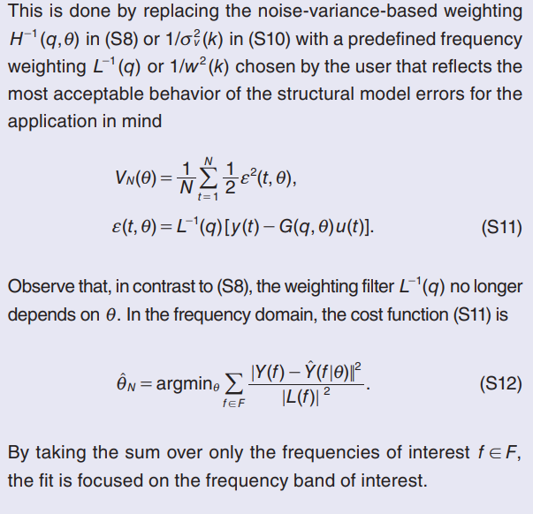
Region of interest & Targeting the peaks
Schoukens & Ljung
Wet-Clutch example: fast but smooth engagement → designed “spiky signals” → forced the system into fast engagement state
  For dual-gantry: similar inputs for training data where the “settling behaviour” is dominant
Weighting function L(q): pre-filter (≈ bandpass filter) on the error signal before the cost is calculated → minimize a “filtered error”
  “The weighting function should reflect in what frequency band larger structural model errors can be tolerated and where small structural model errors are needed.” →
  Use L to translate time-domain goal (stay within ±1.5 µm) into a frequency-domain instruction for the optimizer
Weighted loss function: NN training weight peaks more heavily in the cost function?

Slide 8
Region of interest & Targeting the peaks
Schoukens & Ljung
Wet-Clutch example: fast but smooth engagement → designed “spiky signals” → forced the system into fast engagement state
For dual-gantry: similar inputs for training data where the “settling behaviour” is dominant
Weighting function L(q): pre-filter (≈ bandpass filter) on the error signal before the cost is calculated → minimize a “filtered error”
“The weighting function should reflect in what frequency band larger structural model errors can be tolerated and where small structural model errors are needed.” →
Use L to translate time-domain goal (stay within ±1.5 µm) into a frequency-domain instruction for the optimizer
Weighted loss function: NN training weight peaks more heavily in the cost function?

Slide 9
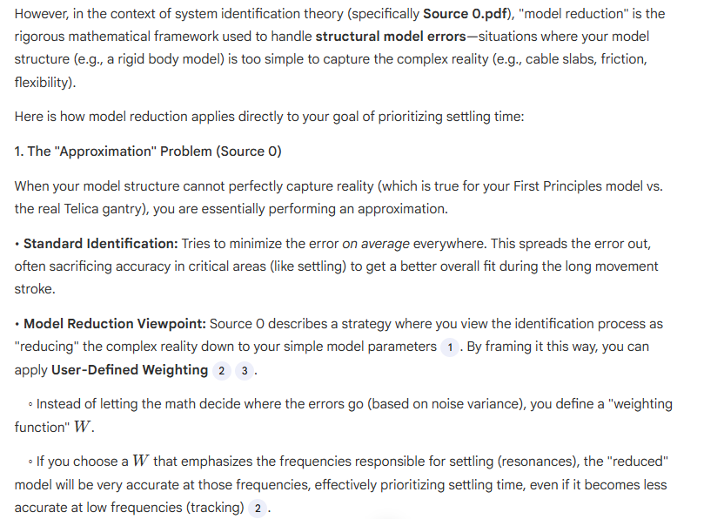
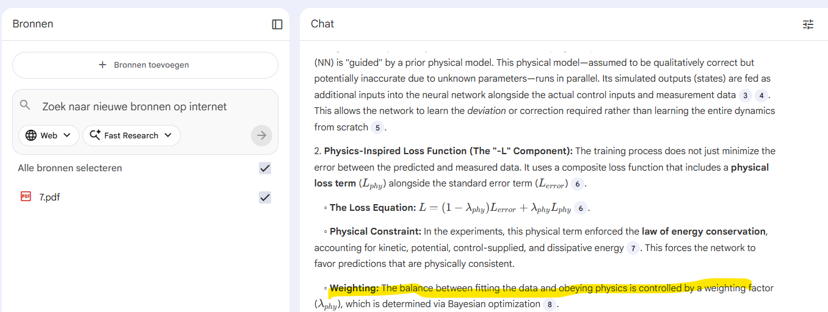
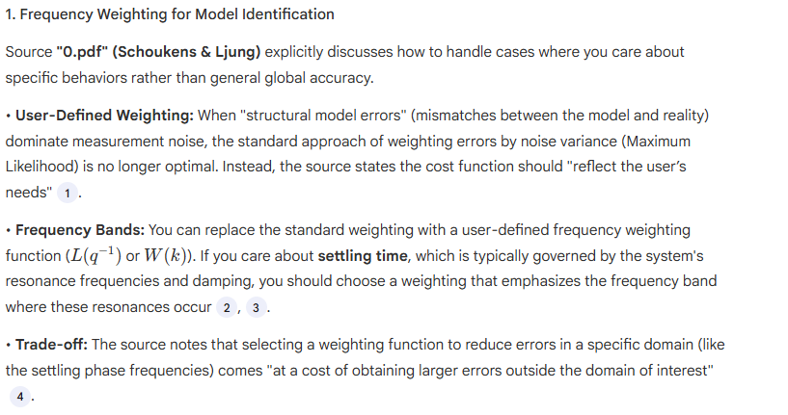
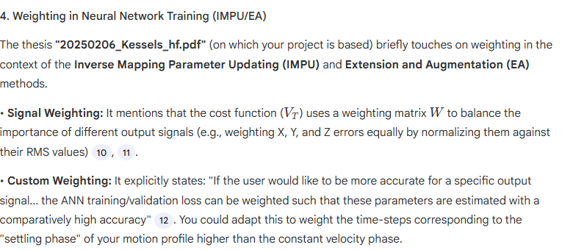
Reference tracking not as important
  So for training the model as metric / cost / optimization settling time
Weighting function; Bayesian optimization pdf 7?
  Kijken weigthing specifieke movements prioritize nn, en hoe dat specifieke moment te labellen / identifyen in training data

Slide 10
The "Trick" in Kessels: Instead of random noise, he generates training data using "alternating smoothed step-up and step-down profiles (closely resembling the steps in the reference profiles used during actual operation
Kessels implements a modern version of this L through Feature Selection
Kessels does not simply feed raw time data into the neural network. He explicitly defines "Frequency Bins of Interest (FBoIs)"—indices of frequency bins located near eigenfrequencies or regions of high energy
The wet clutch example required "spiky signals" to force the valve open. Kessels uses Closed-Loop Feedback during training to force the system into the relevant state space.
1. Imitating Operation: Using realistic "step" profiles for training instead of abstract noise [Source 5, 345].
2. Filtering: Using Feature Selection to weight specific frequency bands (FBoIs) [Source 5, 310].
3. Regime Forcing: Using closed-loop control to force the model into the relevant high-precision settling regime [Source 5, 396].

Slide 11
Extension and Augmentation (EA)
Kessels
Goal: fix mismatch between theoretical First Principles (FP) model and the real physical system
Extension: introduce new state variables that capture unmodeled dynamics
  Subspace Encoder (NN) looks at past data and estimates hidden states
Augmenation: Physical model might have incorrect parameters (or simplified equations)
  EA adds RNNs directly into the force/accelerations equations of the physical model
Negation Problem: NN cancels out physical parameters; NN might take easy route and learn simple dynamics and not the nonlinearities
  Mentions for further research Orthogonality to improve on negation effect

Slide 12
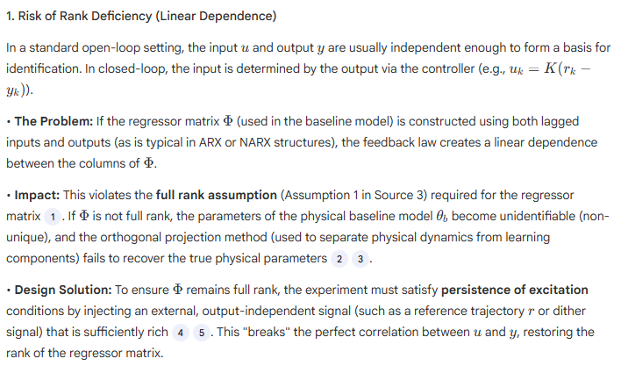
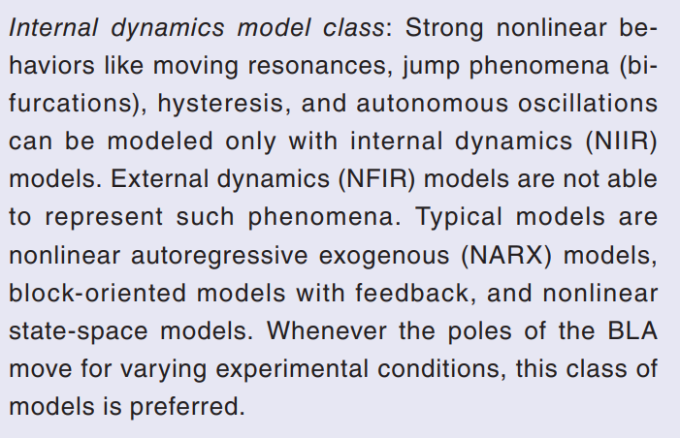
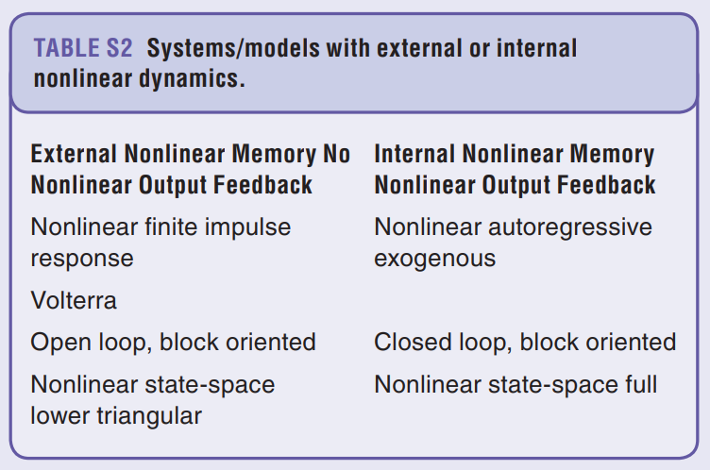
Orthogonality
Orthogonal by construction (ObC) requires input-output, realistic for the dual-gantry system?
Dual-gantry system has position-dependent stiffness → resonance frequencies move → state space
Notes:
Orthogonal by construction currently states that further research for state-space needs to be done
resonance frequencies = poles

Slide 13
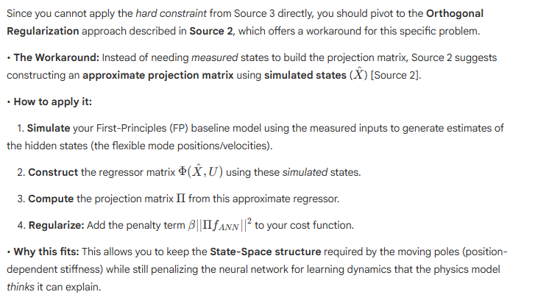
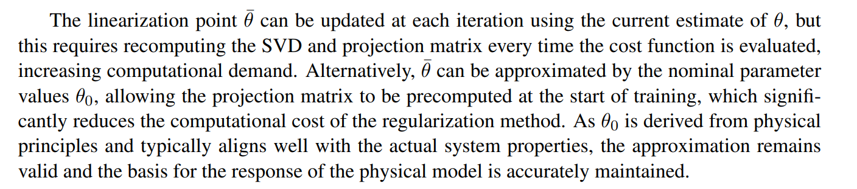
Orthogonal Regularization (State-Space)
Add penalty term to the optimization cost function for predictions that look like rigid-body physics
Use simulated states generated by FP model to construct projection matrix → compatible with Nonlinear State-Space
Linearization point can be updated at each iteration using the current estimate
  Requires recomputing SVD and projection matrix every time the cost function is evaluated → computation expensive
  Only initialize projection matrix at the start of training with initial best guess estimate of the physical parameters → telica datasheets available
Notes:
Orthogonal Regularization for physical parameters vs prediction accuracy for the EA method

Slide 14
LPV-LFR

Slide 15
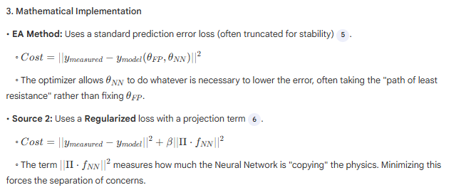
Combining EA with Orthogonality
EA continuously updates physical parameters
Nominal approximation: Initialize SVD once to build projection matrix Π.
  Ideally we would update the SVD at every update step
Feature | EA Method | Orthogonal Method
Primary Goal | Maximize prediction accuracy. | Maximize parameter accuracy & interpretability.
Parameter Update | NN compensates for wrong parameters. | Optimizer corrects parameters because NN is restricted.
Interaction | Competitive (Negation possible). | Complementary (Orthogonal).
Cost Function | Prediction Error only. | Prediction Error + Orthogonality Penalty.
Best For | Complex systems with missing states (flexibility). | Interpretable Digital Twins where m,k must be correct.

Slide 16
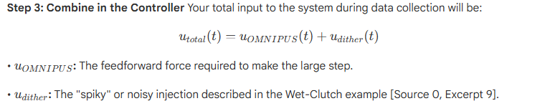
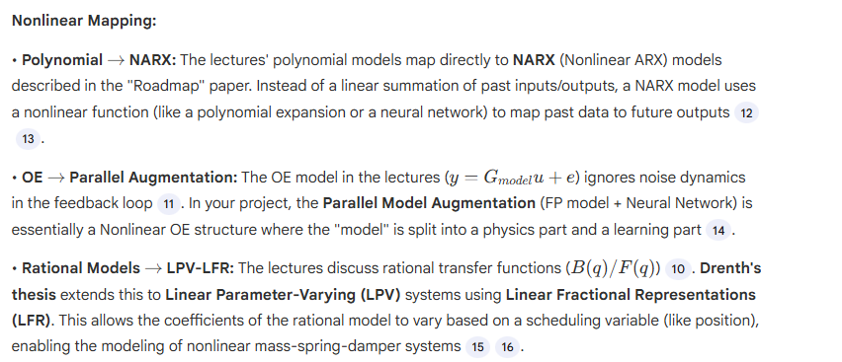
Nonlinear System Identification
Schoukens & Ljung, Kessels
OMNIPUS (OptiMized Nonlinear InPUt Signal): Instead of random noise, generates randomized step-like sequences
  Models better to unseen data
  OMNIPUS responsible for global movement. Combine with “Wet-Clutch Trick” for local excitation?
Selecting regime points for the dual-gantry system
  Need to select specific coordinates that represent extreme cases
  Automate with HILOMOT (HIerarchical LOcal MOdel Tree) algorithm
Notes:
• How it works:
1. Start with a single global linear model for the whole gantry workspace.
2. Calculate the local error across the workspace.
3. Split the space: The algorithm automatically splits the input space (the XY positions) into two halves at the location where the local error is worst.
4. Repeat: It continues to split these regions into smaller "leaves" (local models) until the error is acceptable everywhere [Source 0, 87].
• Why for Gantry: This is ideal for position-dependent stiffness because it will automatically place more regime points in areas where the stiffness changes rapidly (likely near the center of the travel range) and fewer points where behavior is linear/consistent (near the supports) [Source 0, 87].

Slide 17
Regularized Prediction Error Minimization (PEM)

Slide 18
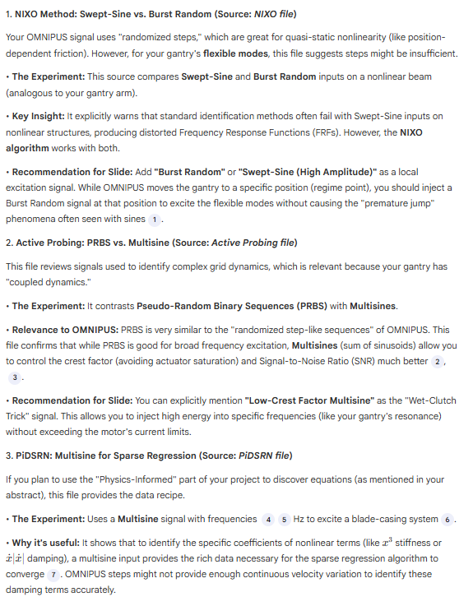
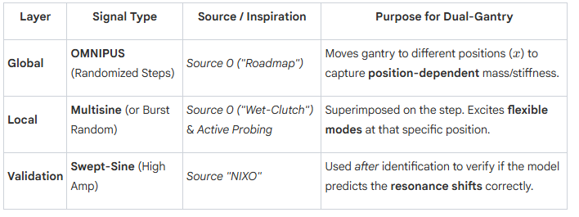
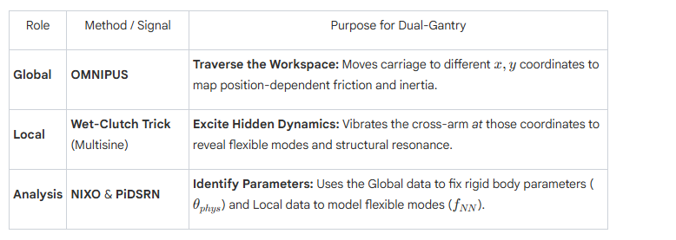
1. NIXO Method: Swept-Sine vs. Burst Random (Source: NIXO file)
  • Constraint: Unlike other frequency-domain methods that estimate complex-valued parameters that fluctuate at every frequency line, NIXO solves a global overdetermined system. This forces the identified nonlinear stiffness parameters to be real-valued and constant across the entire frequency range

Slide 19
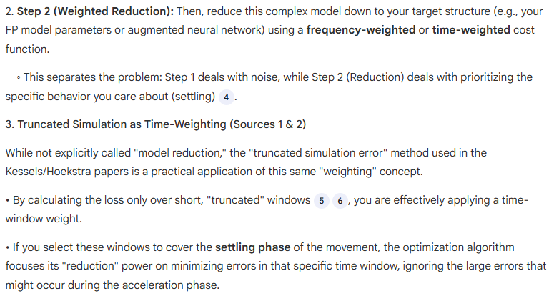
Nonlinear System Identification
Verband leggen lectures maar voor non linear
Implication for SI: You must identify the "unmodeled terms" subspace. Your experiment must be designed so that the regressor matrix of the baseline model is orthogonal to the unmodeled terms in the data

Slide 20
1. NIXO Method: Swept-Sine vs. Burst Random (Source: NIXO file)

Slide 21
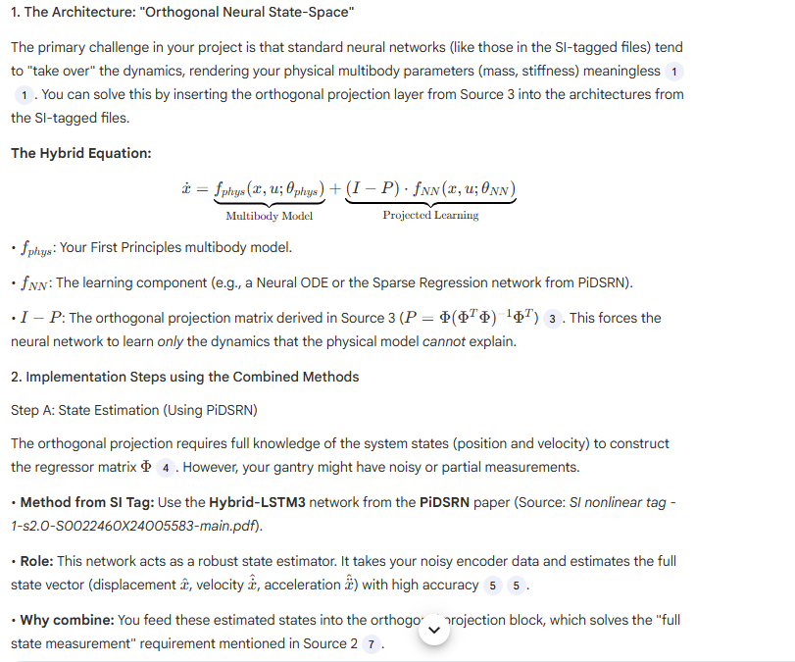

Slide 22
Identification for control (I4C) settling time

Slide 23
Dual-gantry limitations / setup / limited to hardware
You should have a Gantt-chart or some other planning with what should be the next steps in the research.
Questions can also be put here
Some figure showing the result achieved like a plot or some theory.
When applicable, the same as will go in final report. Otherwise just take screenshots from relevant papers.

Slide 24
Action point 1
You should have a Gantt-chart or some other planning with what should be the next steps in the research.
Questions can also be put here
Some figure showing the result achieved like a plot or some theory.
When applicable, the same as will go in final report. Otherwise just take screenshots from relevant papers.

Slide 25
Action point 1
Settling time is the main importance for them. Initial motion not relevant
  Also hysterese can appear where the previous motion interferes with the initial movement. But that error is not really relevant for them.
Voornamelijk presenteren hoe de gegeven bronnen toe te passen op mijn problem? De dual gantry?
  Of wat ik hier uit opgemaakt heb?
En dan nieuwe bronnen? En hoe toepasbaar?

Slide 26
Question 1
If a question needs to be answered. Make clear here what the problem/question is that needs to be answered. Questions can always be asked outside the meeting, but we may say prepare to explain what you really mean.
Some figure explaining the concept
When applicable, the same as will go in final report. Otherwise just take screenshots from relevant papers.

Slide 27
Question 1
What to do about the hidden modes for the nn?/unseen flexible modes, can you anticipate this?
  (The Solution (Dynamic Augmentation): You must use a Dynamic Augmentation structure (specifically an LFR with augmented states)).
    So model keeps improving?
Do we prioritize certain motions? Like anticipating the “clicking in to place” during hybrid bonding
  Weighting the Loss Function; should weight the data samples around the "touchdown" event higher in your training loss function. This forces the NN to focus on minimizing error during that specific impact event, rather than averaging error over the long, easy travel phase.
  Input Design: Your training data must contain many examples of this specific "M2 (Camera to Target)" trajectory mentioned in the datasheet. If you only train on random noise, the model will not learn the specific impact dynamics of the bonding event
How do you model the First Principal model in combination with the augmented model?
  You collect data based on the FP model; how to account for mismatch with input and actual output for when modeling the augmented model?
    Linear Fractional Representation (LFR); The Structure: Instead of just adding outputs (y=yphys​+yNN​), you wrap the physics model and the NN into a single feedback loop
      Block 1 (Physics): You implement your rigid-body equations (M,C,K matrices) as the baseline block.
      Block 2 (Augmentation): You place the Neural Network in the feedback path.
      Interconnection (S): You define a matrix S that routes specific signals (like position error or velocity) from the Physics block into the NN, and routes the NN's output (force corrections) back into the Physics block

Slide 28
Question 1
Simulation model Dragan discarded?
  Any baseline/template models? Or code from scratch?
    PyTorch or JAX
  How important is simulating a physical setup?
    Simulation Models are much harder to train than Prediction Models → Truncated Loss method
This is the Simulation vs. Prediction problem. If you feed the measured input u into your model, the model's simulated state x^ will drift away from the real state x over time due to errors.
  • The Solution (Truncated Simulation / SUBNET):
  ◦ Do not simulate the whole dataset at once (Single Shooting) as gradients will explode.
  ◦ Do not just predict one step ahead (Prediction Error) as this doesn't learn long-term dynamics
    Method: Use Truncated Simulation with an Encoder (Source 1 and 5). Break your data into short bursts (e.g., 100 steps). Use a separate Neural Network (the "Encoder") to look at the past data and guess the optimal starting state for the model for that burst
How to extract individual nonlinearities to specific physical aspects? / How to separatee multiple non linearities?
How important is fast computation for the model, is this something I should take into account beforehand? Like:
  Pre-compute Matrices: If you use Orthogonal Projection to constrain your neural network
Decoupling and orthogonalization, how to combine? Does decoupling the FP model change anything?
The dual gantry system is inherently coupled so even if the FP model is decoupled how do you anticipate this coupling while training the neural network? since you extract data from a coupled system

Slide 29
Orthogonal Regularization?
  B. The "Orthogonal-by-Construction" Approach (Source 3)
  This method (proposed for your specific type of project) hard-codes the orthogonality into the model structure, removing the need for the β parameter.
  1. Jointly estimate the gantry's mass/stiffness and the NN weights.
  2. Guarantee that the found mass/stiffness values remain physically realistic (interpretable).
  3. Ensure the NN focuses purely on the "residuals" (friction, flexible modes, cogging) rather than relearning Newton's law
Semiphysical Modeling (Custom Regressors)
Decoupling Multivariate Functions
  You can "decouple" the error sources. You can structure your neural network so one branch takes only Position (Y) (to learn magnetic cogging) and another branch takes only Velocity (X˙) (to learn friction).

Slide 30
Question: Best weighting technique? Experiments design, cost function, combination?

Slide 31
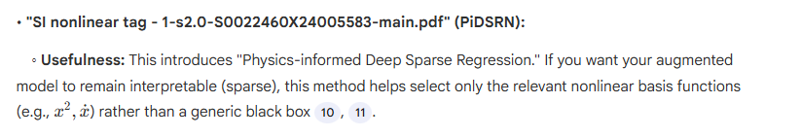
Design process
Look at model augmentation methods → what do I want in time domain → what do I need in frequency domain → what do I need to get from system identification
How much should I currently look for / keep into mind for online computational time for choosing methods / solutions? Since they want to maximize throughput
(Look at mapping multiple nonlinearities, unseen flexible modes)

Slide 32
Outline next week
What is next on the planning and how is that going to be solved
This is also where new action points are formulated. What are you going to do next week.

Slide 33
Possible Gantt-chart or Planning
To keep an overview of what the progress overall is.

Slide 34
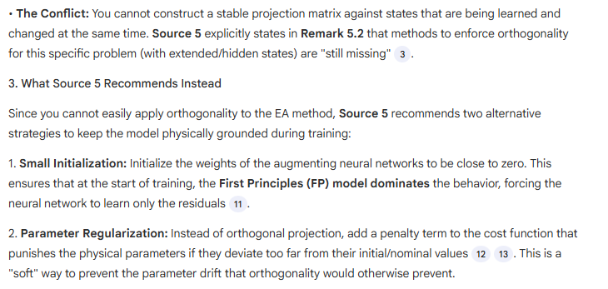
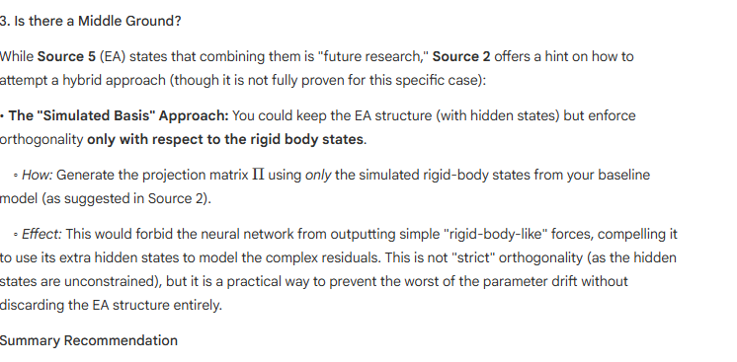
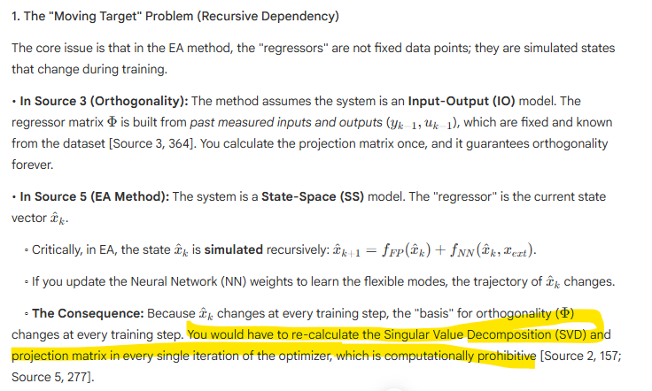
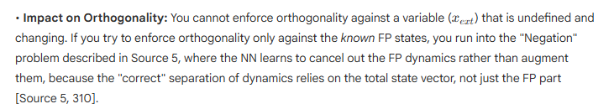
How to combine EA with orthogonalization?
Or focus on identifying or performance?

Slide 35
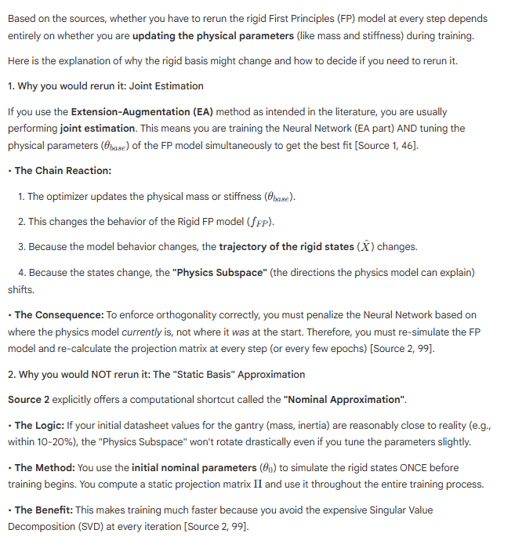
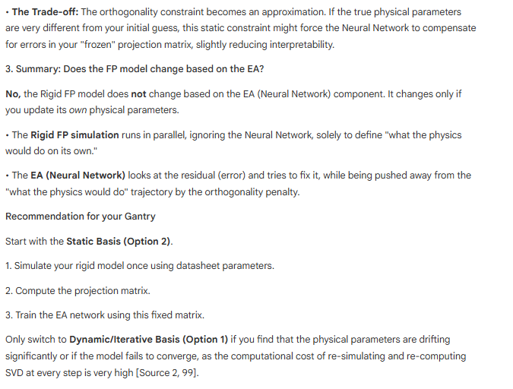

Slide 36
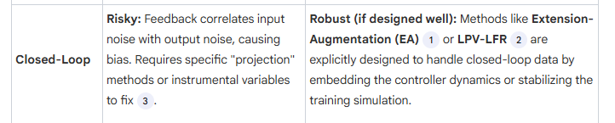
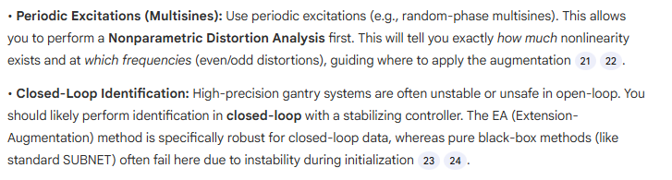
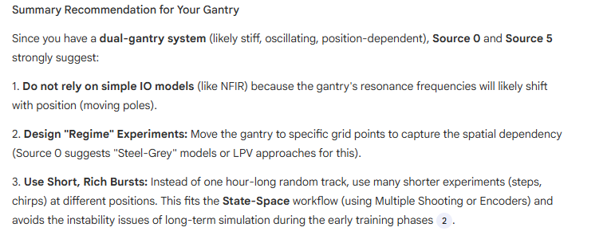

Slide 37
